Slide 1
Climate change in 21 graphs
I like numbers…

Slide 2
Greenhouse effect

Slide 3
Global Carbon dioxide emissions 1600 – 2000

Slide 4
Concentration of GHG from 0 to 2005

Slide 5
Global emissions per capita since 1751

Slide 6
Global and Hemispheric Annual Temperature Anomalies (1850 -2012)

Slide 7
Radiative forcing of climate between 1750 and 2005

Slide 8
Characteristics of GHG

Slide 9
Total GHG Emissions by Groups of Gases (1970 -2010)

Slide 10
Global GHG emissions by economic sectors, 2010

Slide 11
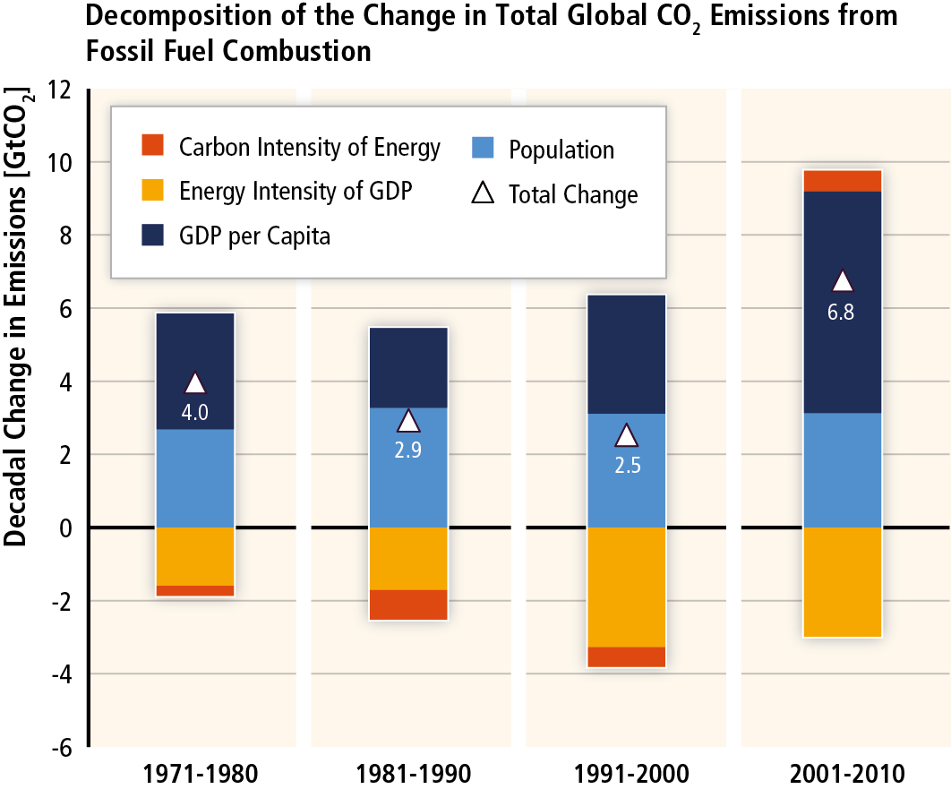
Decomposition of the change in Total Global CO2 Emissions from Fossil Fuel Combustion

Slide 12
Annual emissions 2009

Slide 13
Cumulative emissions 1751 -2009

Slide 14
CO2 Emissions per Capita by Country 2013

Slide 15
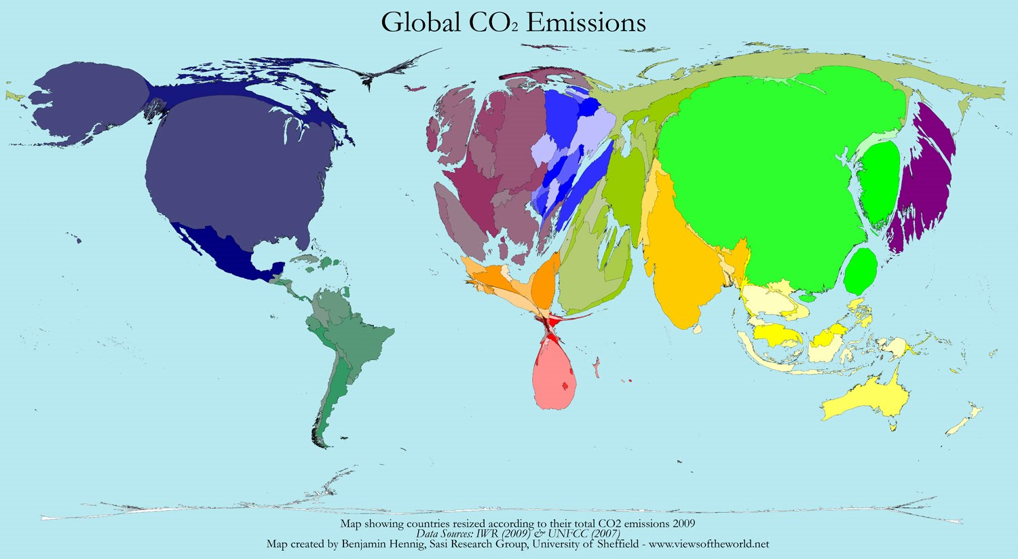
World map of CO2 emissions

Slide 16
The Projections of the Earth´s Future Climate

Slide 17
Stabilization levels and probability ranges for temperature increases

Slide 18
Fossil fuel resources

Slide 19
Are scientists sure?

Slide 20
Are humans big enough to change the climate?

Slide 21
Fossil Fuel Subsidies versus Fast Start Climate Finance

Slide 22
Planetary boundaries framework

