Slide 1
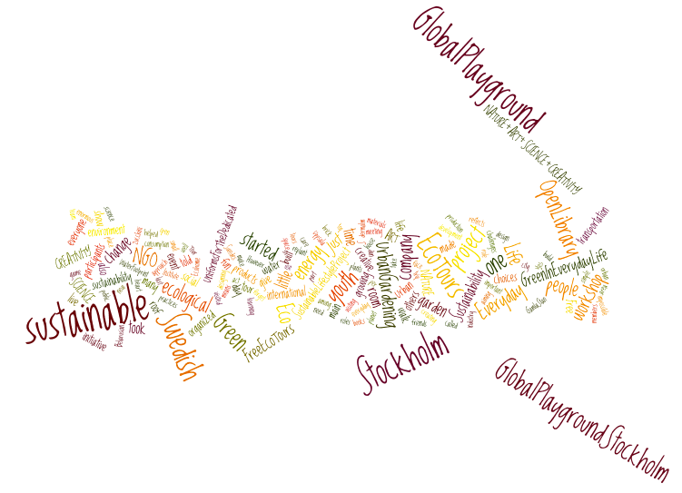
1 June, CENEAN

Slide 2
Global Playground Stockholm
NATURE + ART + SCIENCE + CREATIVITY = Sustainability
Who? NGO ruled by Swedes and international youth
For whom? Youth in Stockholm
Our aim? Promote sustainable lifestyle and through that empowering youth

Slide 3
Team:
Stiva Liwiz
Aleh Kliatsko
Irina Mikhnovets
Arianna Montanari

Slide 4
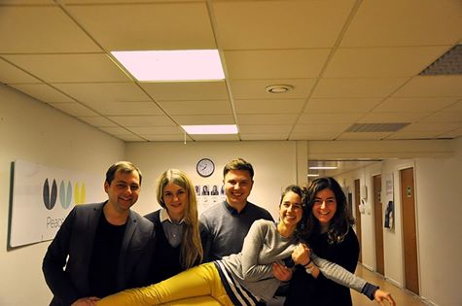
What do we do?
cultural exchange Sweden - Ukraine - Belarus
cultural enrichment and integration in Sweden
art projects
connecting people
sustainable lifestyle workshops
promoting sustainability
playful education

Slide 5
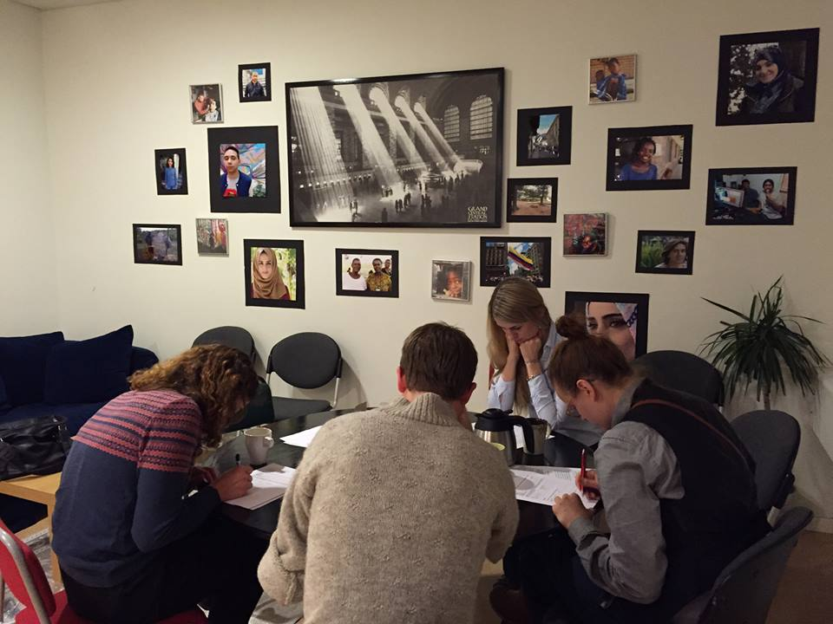
Introduction/Initial questionnaire

Slide 6
Introduction:
September: 2 families -> 6 families (target: 10 families)
Apartments is high developed regarding technology installation
Main focus of GP:
Human behavior
Energy consumption
Water consumption
Waste Management
Lifestyle
(Green in everyday life)

Slide 7
Audit:
September – October 2015

Slide 8
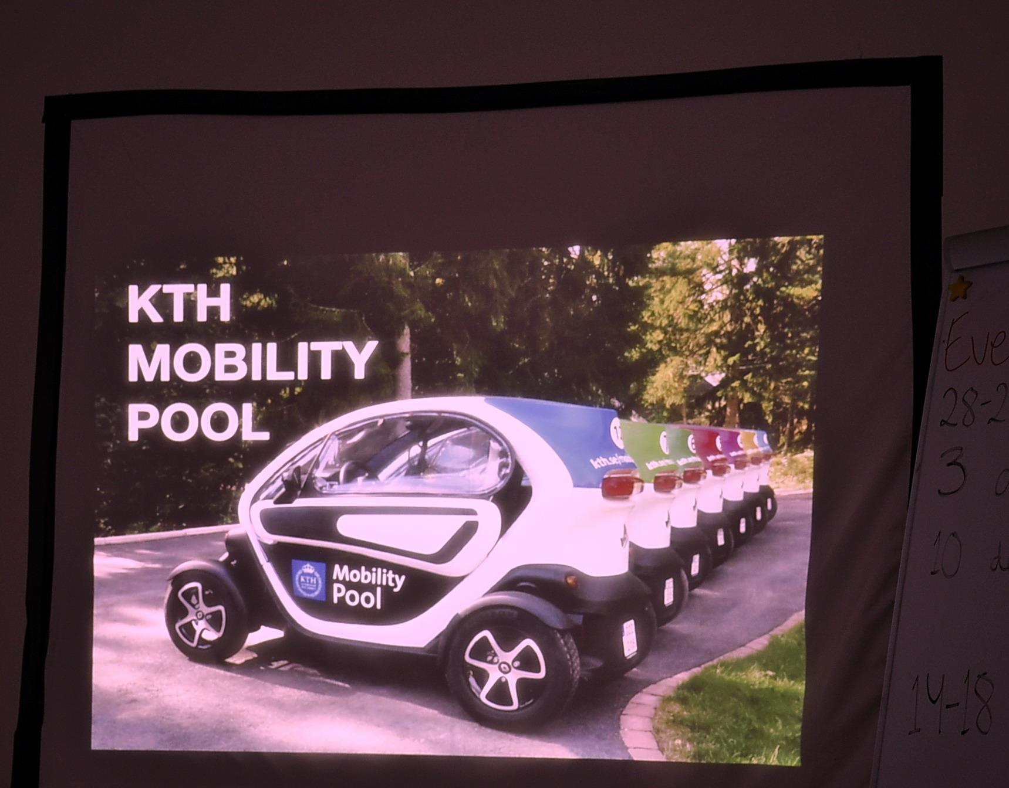
Workshop 1:
November:
1. Movie night on sustainable mobility (the film Bikes vs Cars); + innovative sustainable cleaning
Number of participants: 7

Slide 9
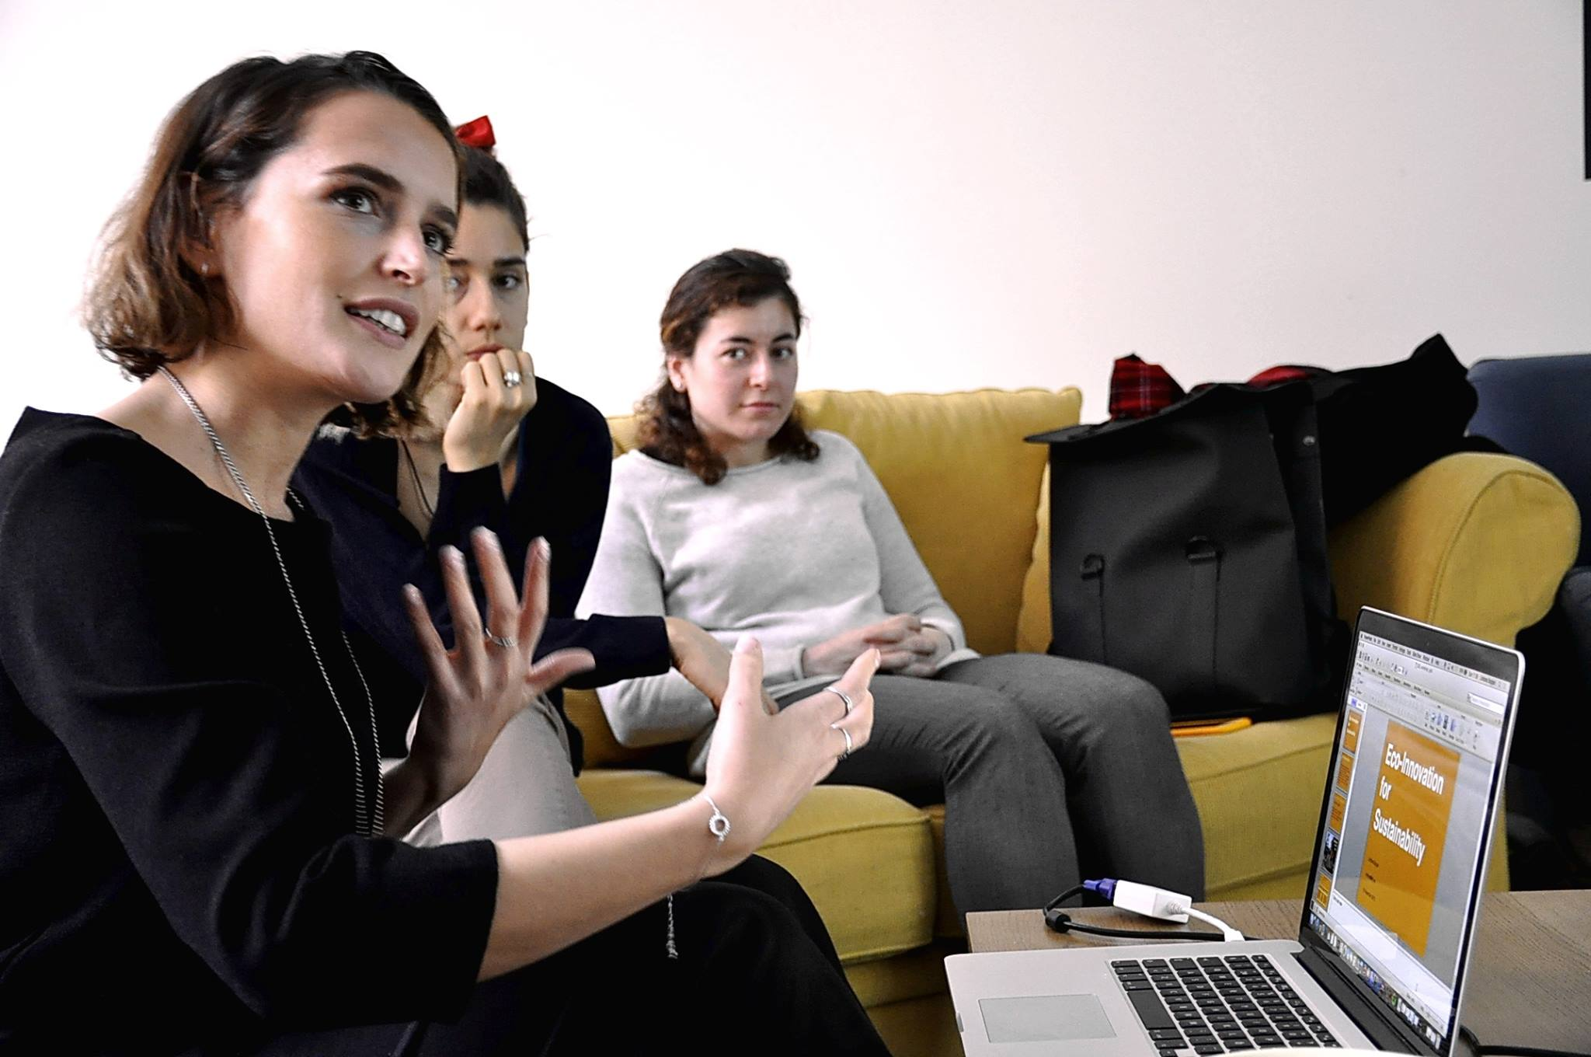
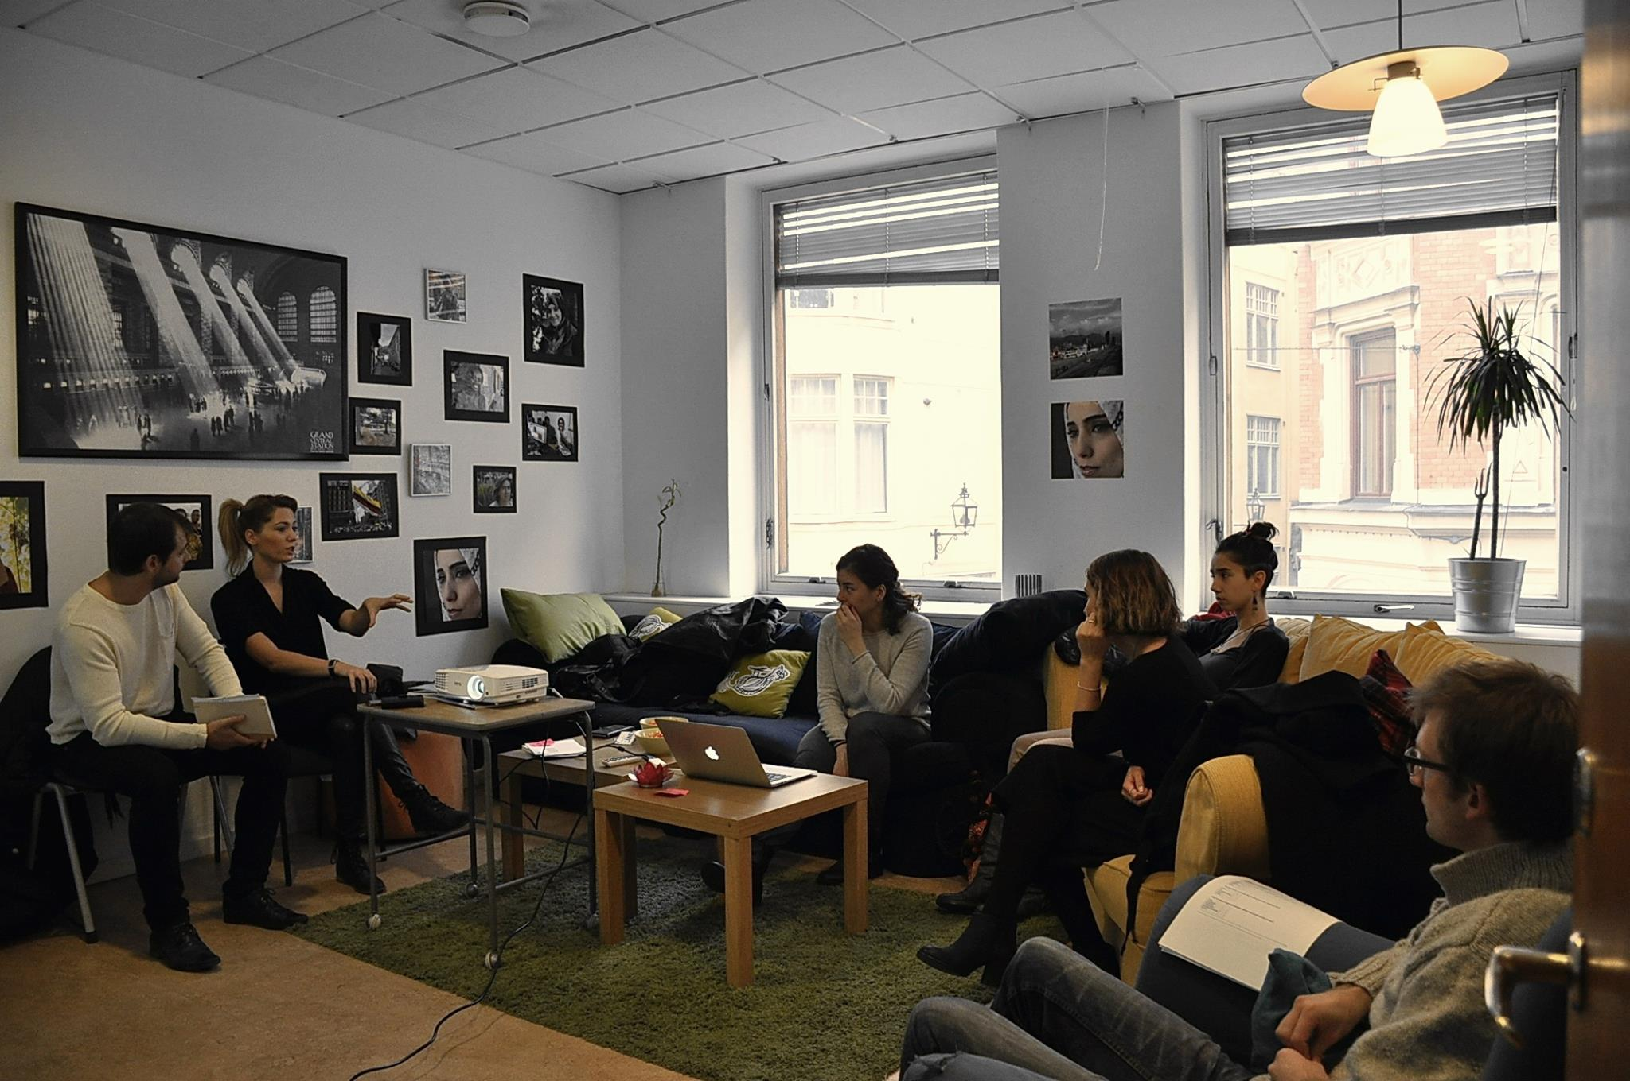
Workshop 2&3:
November:
2. Energy saving
3. Water saving
Number of participants: 7

Slide 10
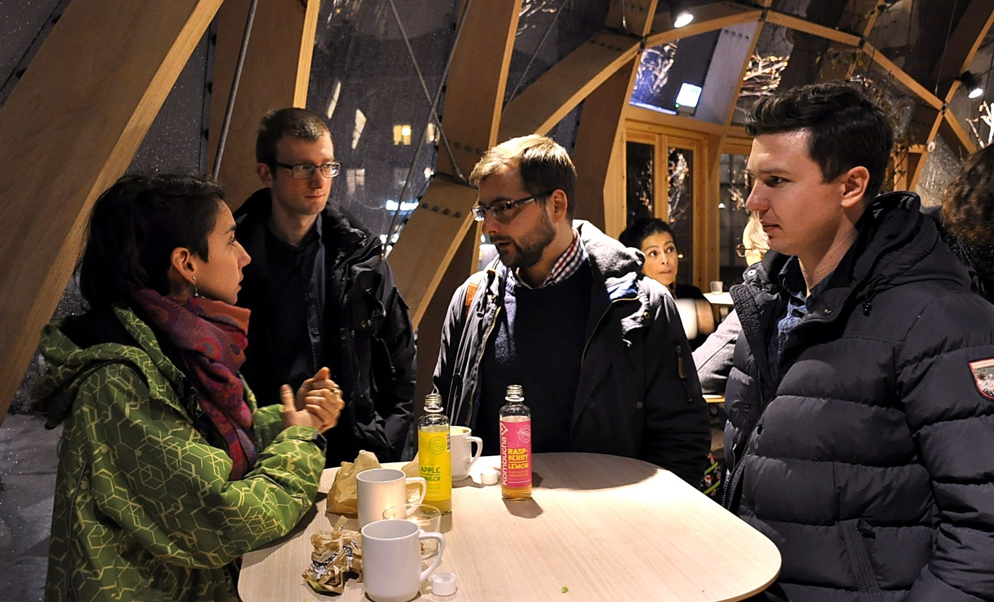
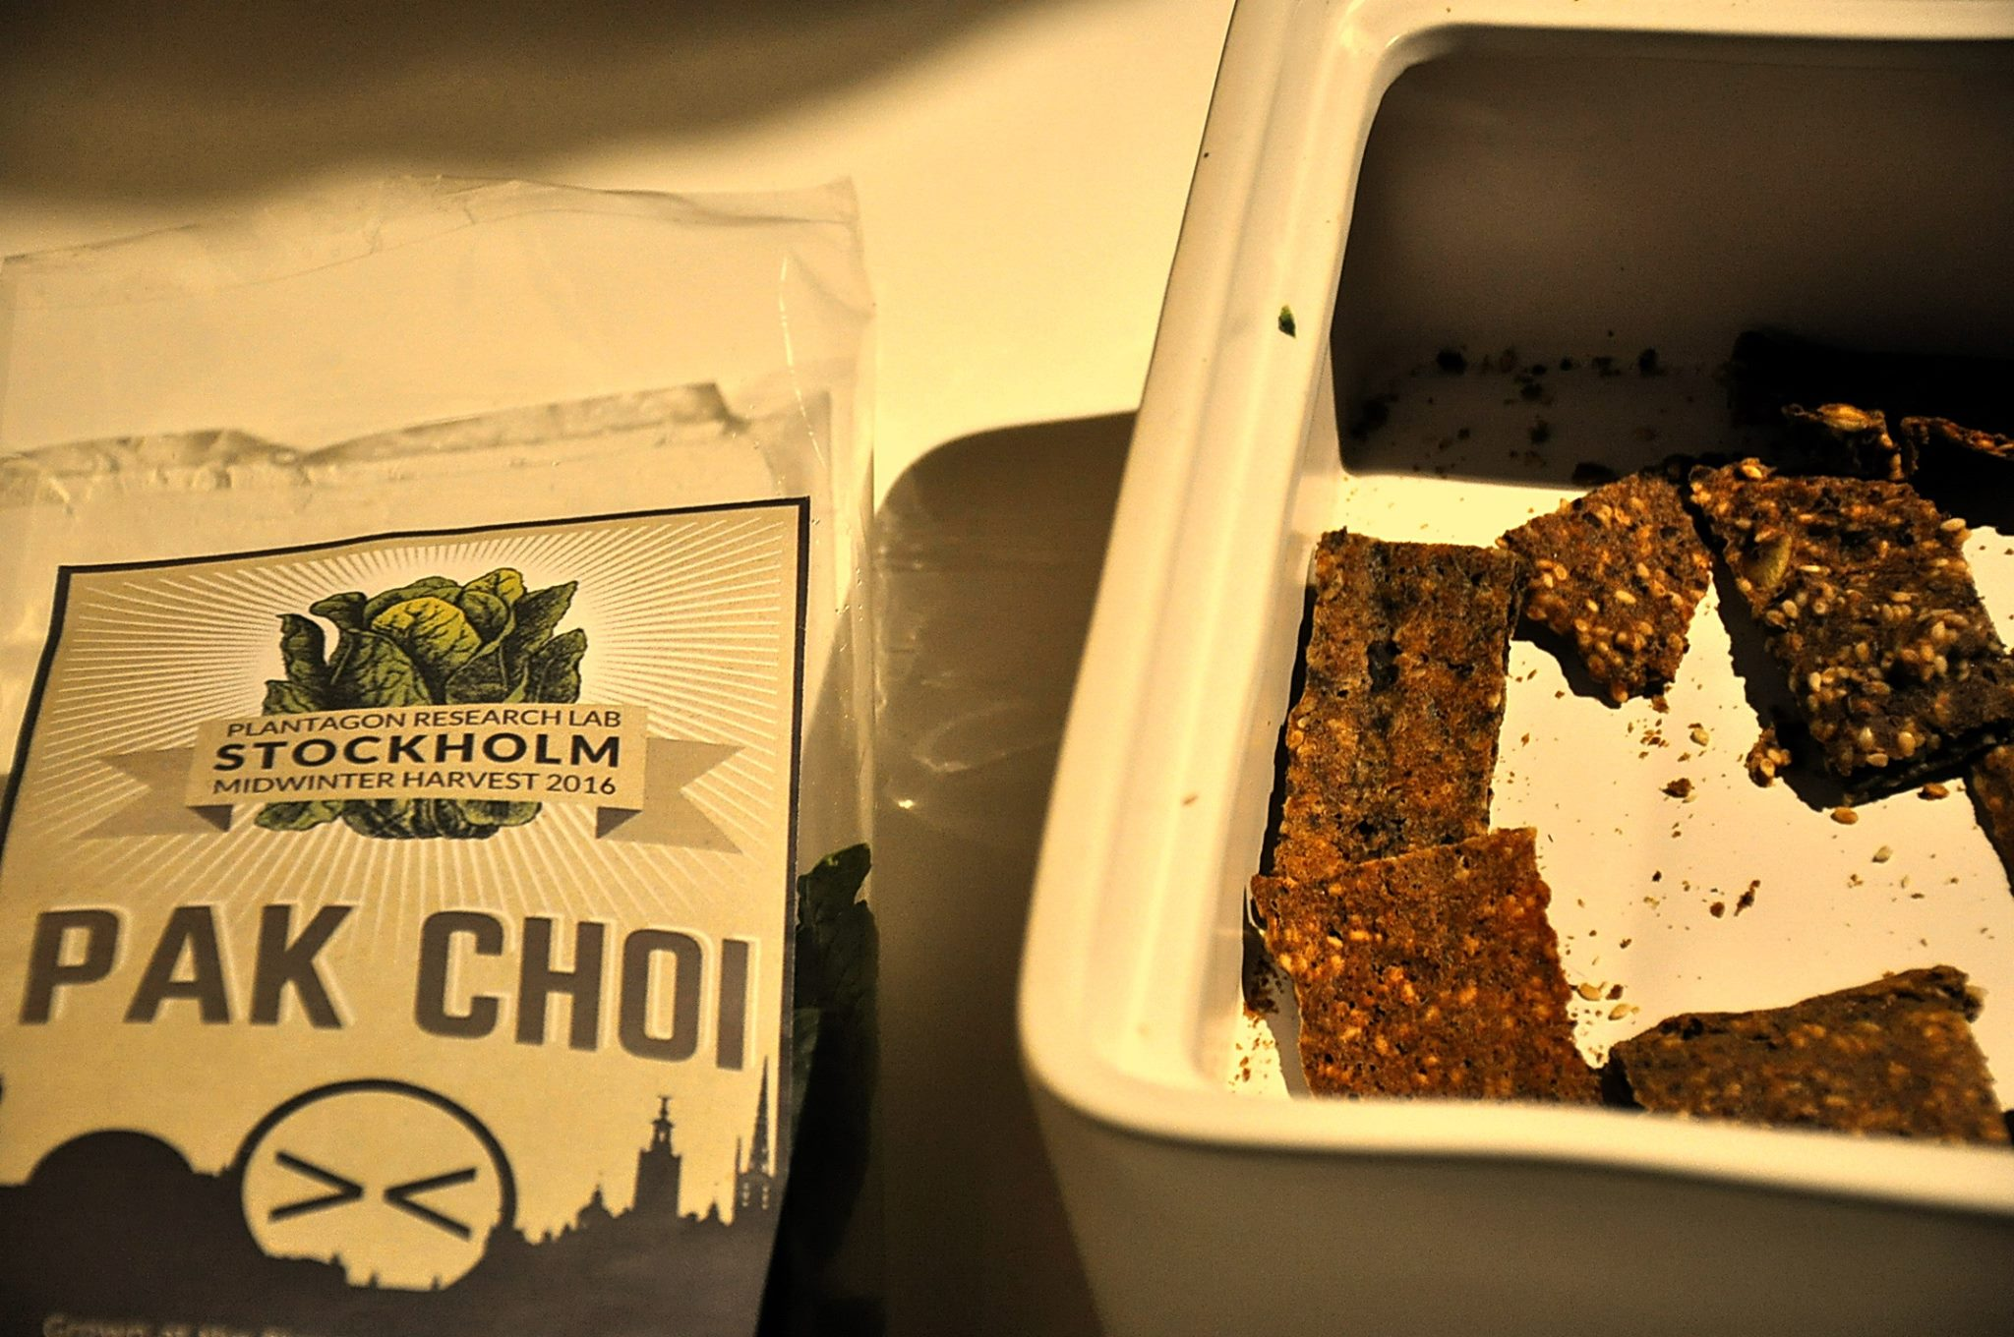
Workshop 4:
February:
4. The future food
Number of participants: 6

Slide 11
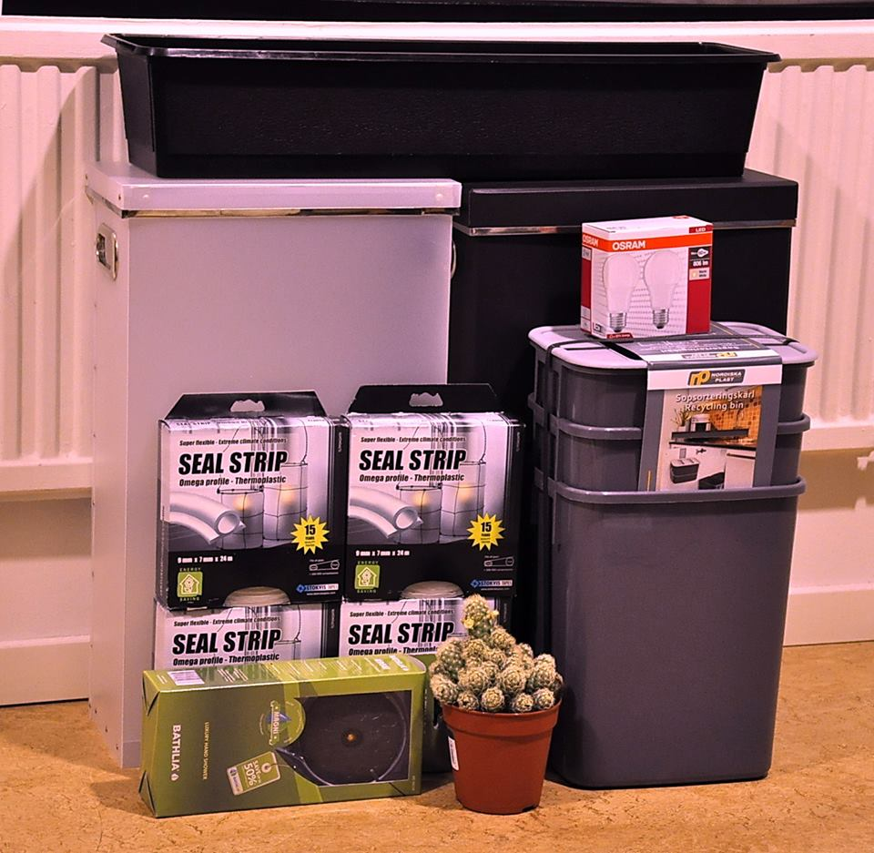
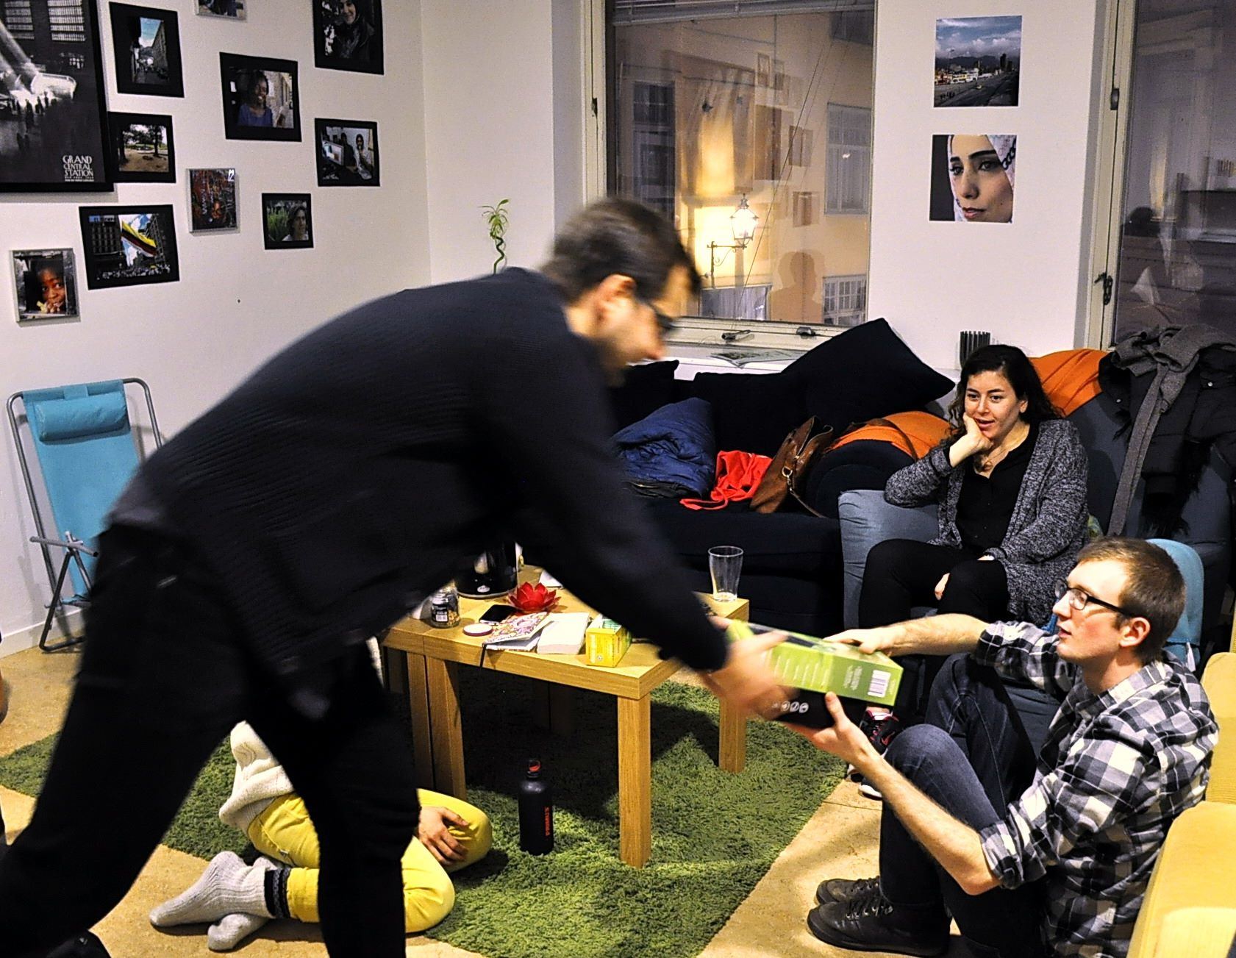
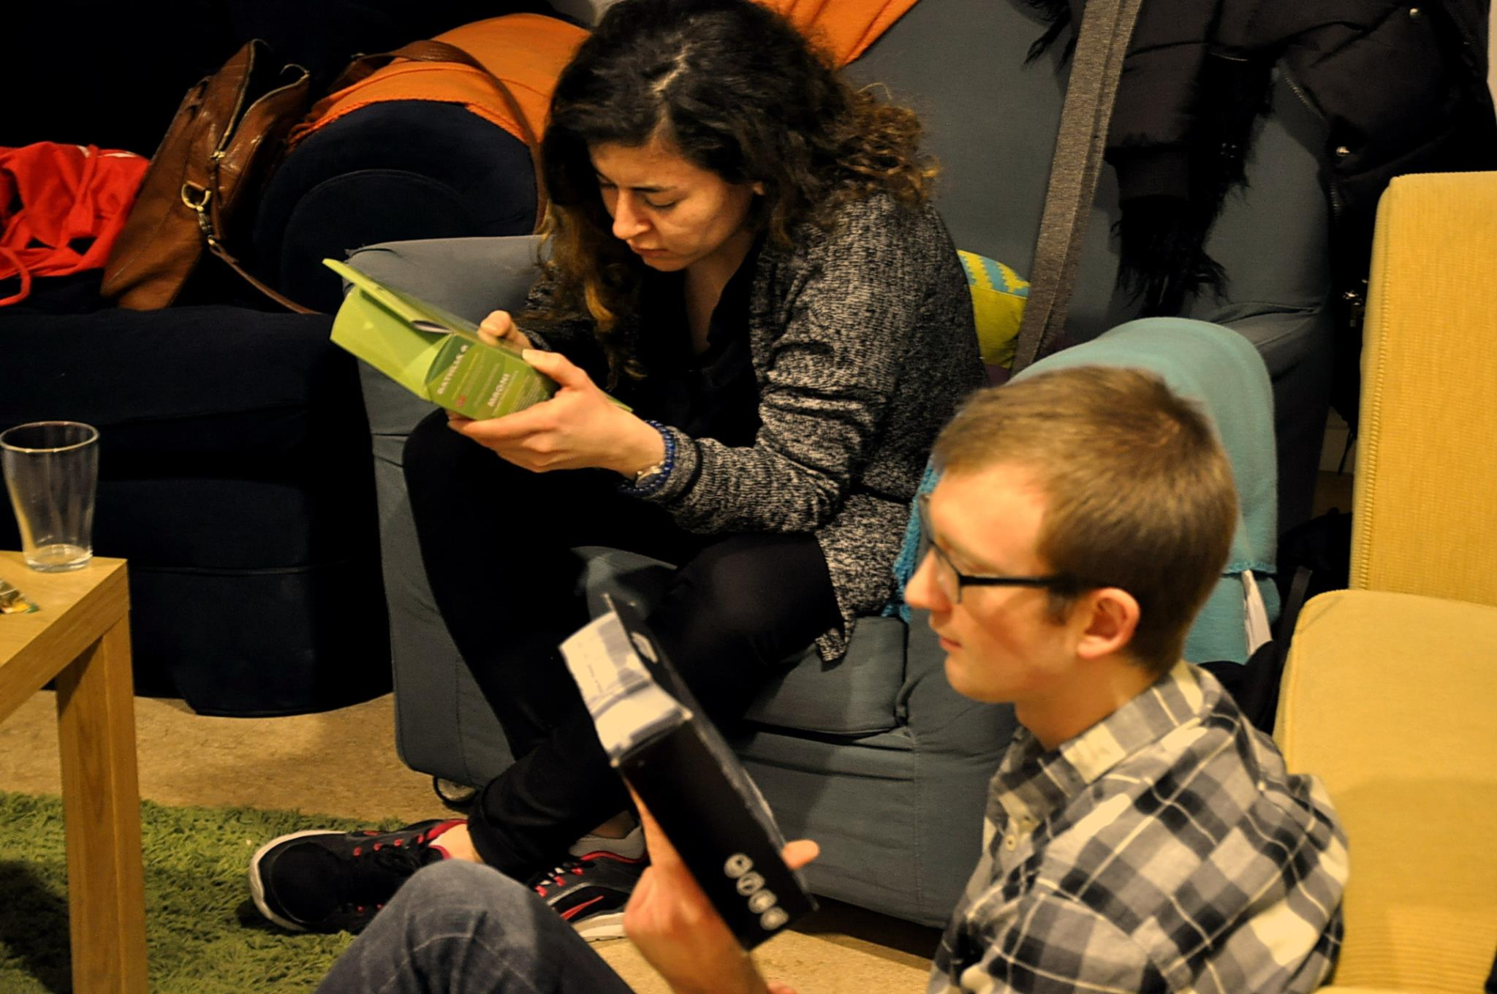
Workshop 5:
February:
5. Sustainable kits
Number of participants: 6

Slide 12
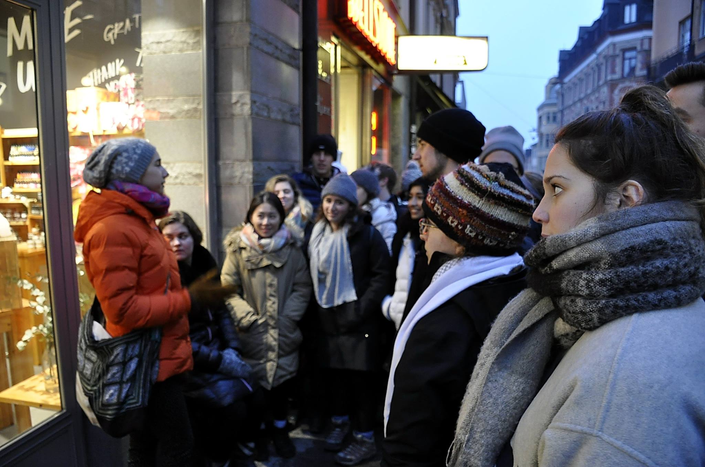
Workshop 6:
March:
6. Eco tour
Number of participants: 5

Slide 13
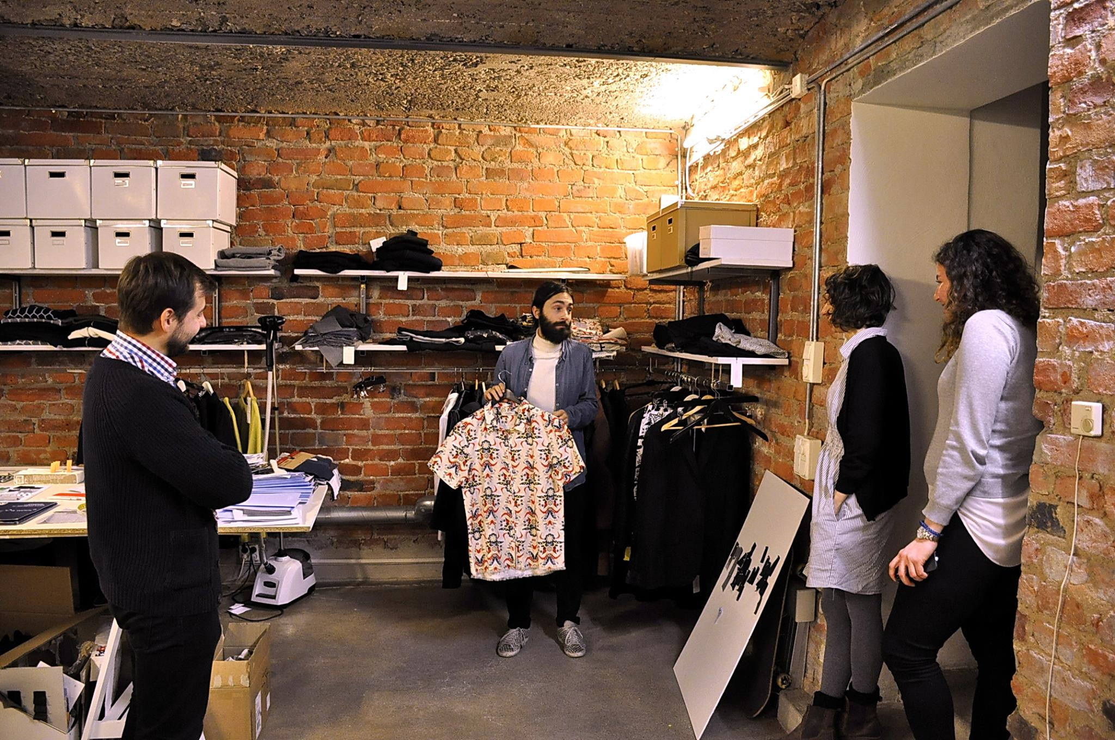
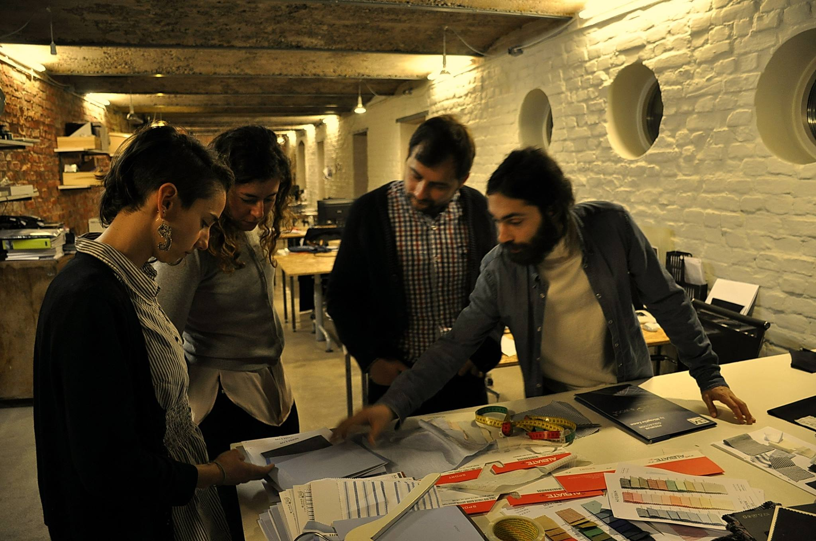
Workshop 7:
March:
7. Responsible consumption
Number of participants: 5

Slide 14
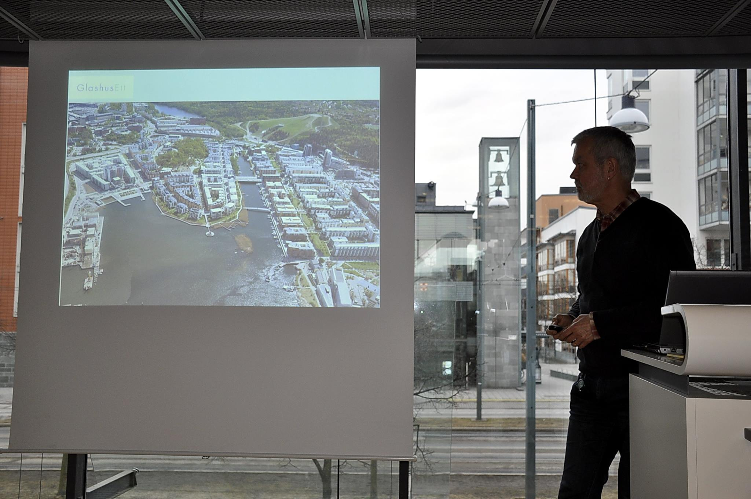
Workshop 8:
March:
8. Waste management
Number of participants: 5

Slide 15
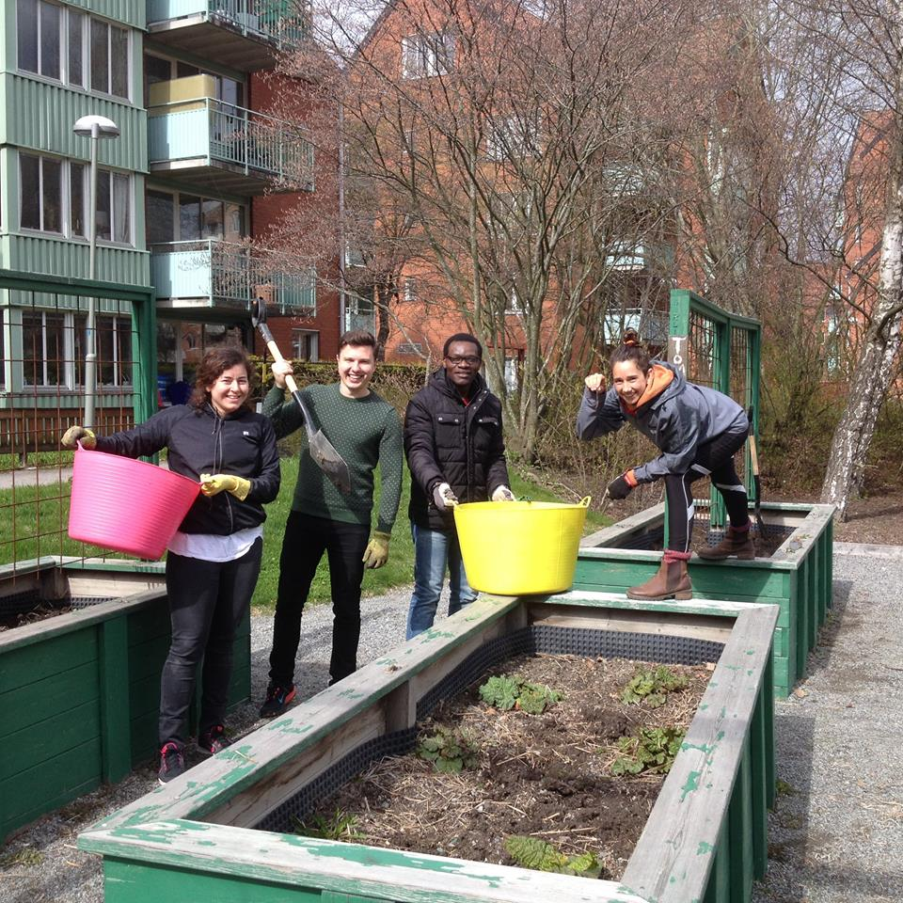
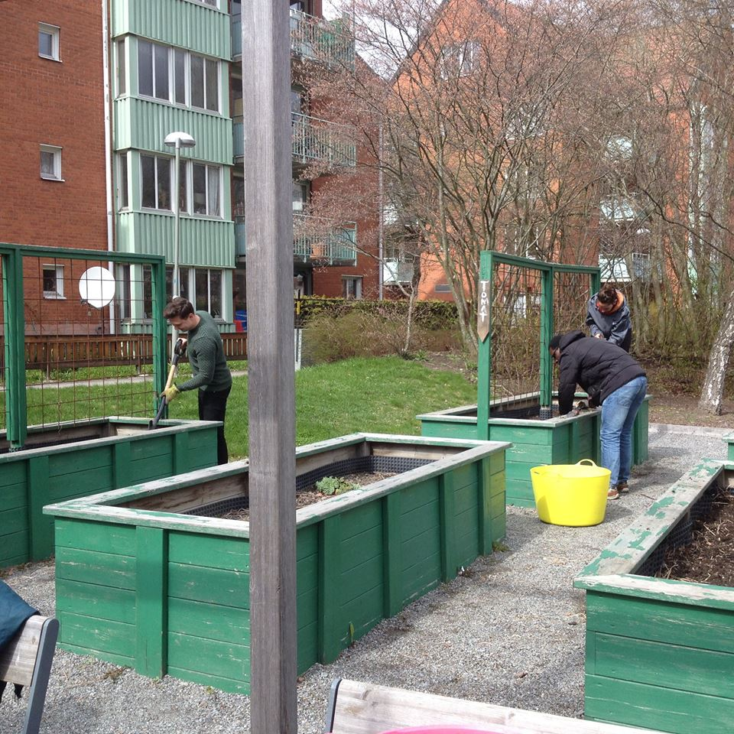
Workshop 9:
April:
9. Urban gardening
Number of participants: 5

Slide 16
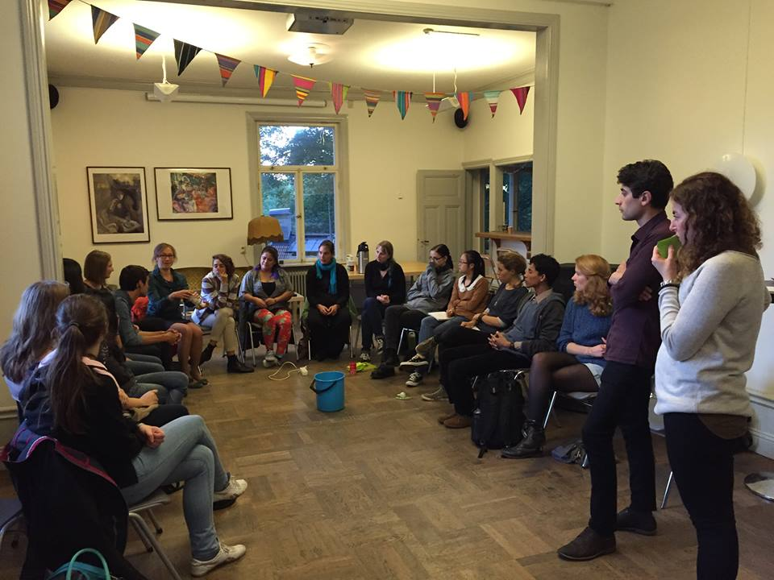
Stockholm Earth Week 2015

Slide 17
Dissemination:
Global Playground Stockholm’s website
PeaceWorks Sweden
Globalportalen
Debate article at Biståndsdebatten
SU website
Stockholm Earth Week website
GP’ Facebook, Twitter, Instagram, blog
SI News Service The Local

Slide 18
Questionnaire:
Final Questionnaire: to compare data before and after all workshops
March-April

Slide 19
Difficulties:
Difficult to find families interested to participate
Housing companies are not interested to cooperate (cooperation with Micasa)
No data to compare
Families recently moved to their apartments
How to compare behavior?
Final debate (opinion) article will be submitted to Biståndsdebatten

Slide 20
Global Playground Stockholm
www.globalplaygroundstockholm.com

