Slide 1
MONITORING, EVALUATION AND REPORTING
Carmen Molina Navarro

Slide 2
1. Technical monitoring, evaluation and reporting: - Internal: - Reports - External: - Follow-up report - Final report - Erasmus+ dissemination platform 2. Economic monitoring, evaluation and reporting: - General - Reporting of the travel expenses - Other expenses 3. Monitoring, evaluation and reporting of the personal: - Transnational meetings - Intellectual outputs - Initial training course - Final conference 4. Monitoring, evaluation and reporting of communication and dissemination: - Websites and social networks of the partners - Press releases - Public presentations 5. Monitoring, evaluation and reporting of Mini Green Homes Programme: - Audits - Workshops - Results of saving energy, water and waste and changes in consumption habits and mobility 6. Monitoring, evaluation and reporting of the International Green Homes network 7. Monitoring, evaluation and reporting of the job shadowing activity
Monitoring, evaluation and reporting of GH Programme:

Slide 3
- Internal: The partners send the Association Columbares three project monitoring reports in: - September 2015 - January 2016 - July 2016 according to a model previously prepared by the Association Columbares.
1. Technical monitoring, evaluation and reporting:

Slide 4
- External: - Follow-up report: it was sent by Association Columbares on April 30, 2015. - Final report: - It will be generated in the mobility tool by Association Columbares. - Before generating the report we will have to upload all the economic data in the mobility tool, as well as all the participants in all the international events will have to fill in evaluation questionnaires. - Columbares will ask all the partner organizations to provide the necessary documentation and information for each section, as well as all verifications for activities and expenses needed .
1. Technical monitoring, evaluation and reporting:

Slide 5
- External: - Erasmus+ dissemination platform: - It will be used to upload information on intellectual products and transnational meetings. - The Association Columbares will be responsible for uploading this information to the platform, but may ask for the partners’ contributions, if deemed necessary.
1. Technical monitoring, evaluation and reporting:

Slide 6
- General: - Presentations of bank transfers to the partner entities. - Presentations of the contracts signed between the partner entities and Columbares. - Reporting of the travel expenses: - The partners will send to the Association Columbares: - Originals of the boarding passes, train tickets, bus, taxi, etc. and invoices from the travel agencies or transport companies. - Each participant must complete a per diem and travel expenses form , detailing their expenses. - Dates of sending: July and December 2015 and June 2016.
2. Economic monitoring, evaluation and reporting:

Slide 7
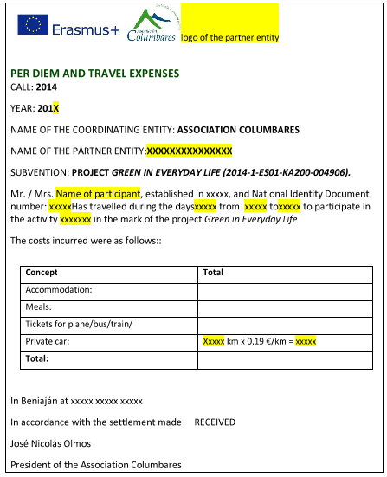

Slide 8
- Other expenses: - Design of the intellectual outputs: These expenses are included in the budget on “Project management and implementation”. We have: - Common costs of the project: - GH Starters Kit (375 €; 54 €/partner) - GH Manual - Individual costs of the project: each country may be included in the money we transfer them . *mostrar todos los logos y diseño del manual; preguntar si alguien puede completar el diseño.
2. Economic monitoring, evaluation and reporting:

Slide 9
- Transnational meetings: Participants in transnational project meetings should be persons directly linked to the sending organisation, as employees or as volunteers. The partner organizations should be sent to the Association Columbares: - Payroll or - Volunteer agreements which should include the dates of the meetings. The entity organizing transnational meeting will prepare certificates of attendance.
3. Monitoring, evaluation and reporting of the personal:

Slide 10
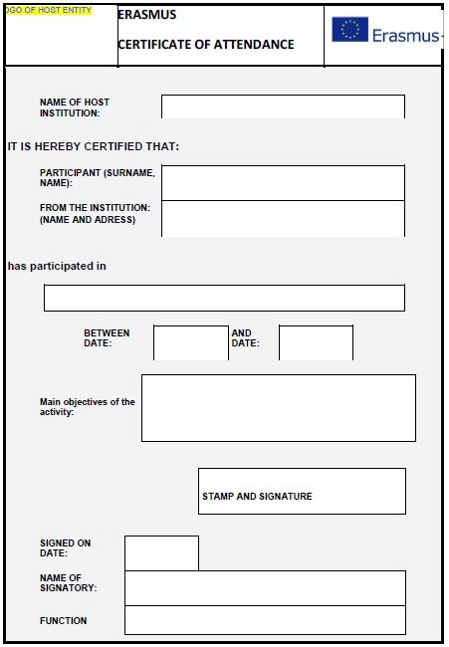

Slide 11
- Transnational meetings: The assistants will have to sign attendance sheets.
3. Monitoring, evaluation and reporting of the personal:

Slide 12
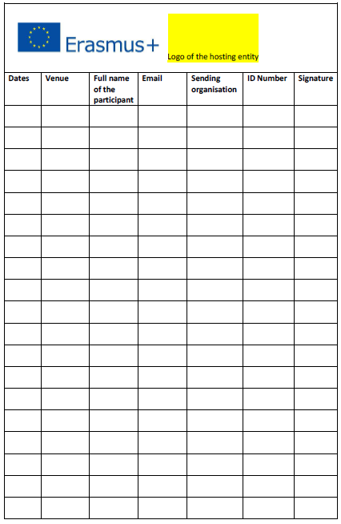

Slide 13
- Transnational meetings: Participants further will have fill out a satisfaction questionnaire. The host entity will also prepare the minutes of the conclusions and agreements from the meeting, which serve to both internal communication between the partners as well as to verify this activity to the National Agency. Finally, the partners will have to provide information on the participants to be included in the Mobility tool.
3. Monitoring, evaluation and reporting of the personal:

Slide 14
- Intellectual outputs: Our intellectual products are: - GH Starters Kit: 10 days Columbares proffessors + 10 days Insider Access technitians. - GH Manual: - 30 days Columbares technitians - 5 days Bassing Guir, Consorzio abn, EA Center, Global Playground - 8 days Insider Access
3. Monitoring, evaluation and reporting of the personal:

Slide 15
- Intellectual outputs: For the verification the partners will have to: 1. Send to Columbares the work sheets signed by the workers, which indicate the hours spent by their staff (work or volunteer) on the development of these intellectual products, as well as the name of the staff category under the terms indicated in Annex III of the agreement, dates and total number of working days. The work sheets should be sent in June 2015 (GH Starters Kit) and July 2016 (GH Manual). 2. Send to Columbares Association payroll of workers or voluntary agreements, which should coincide with the date of preparation of the corresponding intellectual products. 3. Upload the intellectual outputs in your websites. The Association Columbares will upload the Intellectual Outputs in the dissemination platform and the information on the working hours in the Mobility tool.
3. Monitoring, evaluation and reporting of the personal:

Slide 16
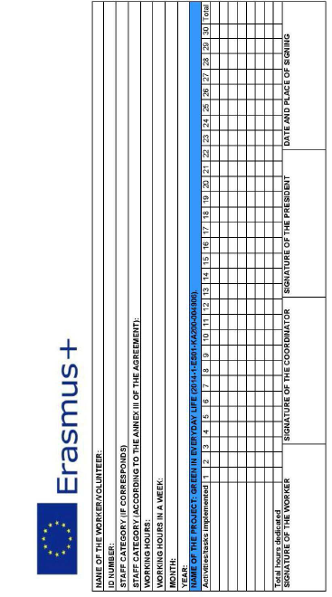

Slide 17
- Inital training course: For the verification the partners will have to: 1. Sign attendance sheets. 2. Fill an evaluation questionnaires at the end of the training course and in the Mobility Tool. 3. Send to Columbares Association payroll of workers or voluntary agreements, which should coincide with the date of the training course. CENEAM will prepare attendance certificates.
3. Monitoring, evaluation and reporting of the personal:

Slide 18
- Final conference: For the verification the partners will have to: 1. Sign attendance sheets. 2. Fill an evaluation questionnaires at the end of the training course and in the Mobility Tool. 3. Send to Columbares Association payroll of workers or voluntary agreements, which should coincide with the date of the training course. CENEAM will prepare attendance certificates.
3. Monitoring, evaluation and reporting of the personal:

Slide 19
Websites and social networks of the partners: Partners will send the Association Columbares links to the publications. Press releases: Partners must submit: - Clippings (digital or scanned) from the newspapers of - Links to the news published in other media (web and social networks of others entities, online newsletters, etc.). - Audio or video recordings of TV or radio programmes.
4. Monitoring, evaluation and reporting of communication and dissemination:

Slide 20
Public presentations: For the verification partners will send to Association Columbares: - Graphic documentation (photos) - The programme of the event in which the presentation is included (if such programme exists) - Confirmation signed by the event representative. In addition, organisations making public presentations must upload information on this event on their website.
4. Monitoring, evaluation and reporting of communication and dissemination:

Slide 21
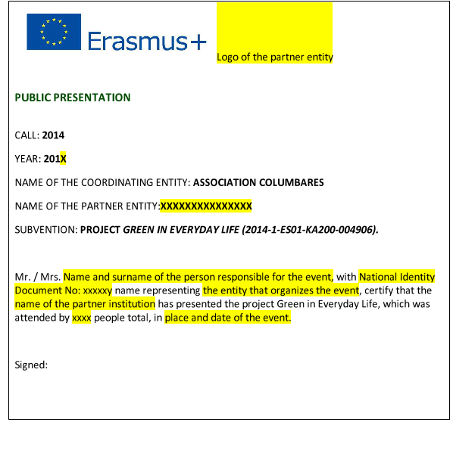

Slide 22
Public presentations: As minimum, the project will be presented in the following ways: - Earth Week in Stockholm. Responsible entity: Global Playground. - Hogares Verdes Conference. Responsible entities: CENEAM and Association Columbares. - Policy Makers Conference. Responsible entity: Insider Access. - Local authorities in Jordan (at least three presentations). Responsible entity: East & West Centre for Human Resources Development. ¿Dates?
4. Monitoring, evaluation and reporting of communication and dissemination:

Slide 23
Audits: As minimum, each partner must organize the following number of audits: - Insider Access: 13 families from Hemel Hempstead, 13 saving kits and 45 direct beneficiaries. - WE Center: 20 families, 20 saving kits and 80 direct beneficiaries. - Global Playground: 10 families, 10 saving kits and 25 direct beneficiaries. - Columbares: 150 direct beneficiaries, 6 environmental audits, 60 saving kits. - Basin Guir Association: schools with total of 90 direct beneficiaries, 6 environmental audits and 15 Savings Kits. - Consorcio ABN: schools with total of 120 direct beneficiaries, 6 environmental audits and 30 domestic Savings Kits.
5. Monitoring, evaluation and reporting of Mini GH Programme:

Slide 24
Audits: The verification will be made through: - A confirmation signed by the person responsible for the activity. - A satisfaction questionnaire. - Graphic documentation (photos or videos) from the audits. - Providing information related to audits for the Mobility Tool.
5. Monitoring, evaluation and reporting of Mini GH Programme:

Slide 25
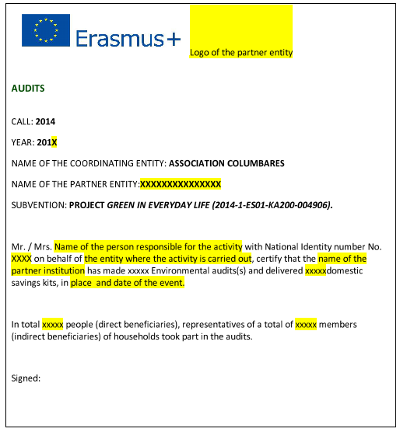

Slide 26
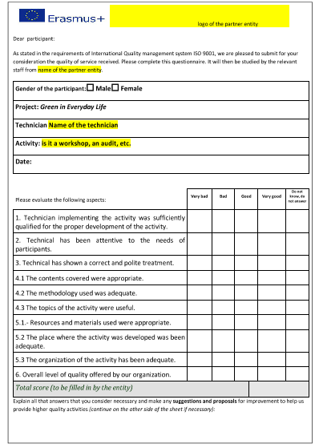

Slide 27
Workshops: As minimum, each partner must organize 9 workshops on the topics of: - Saving water and energy - Reducing waste - Responsible consumption - Sustainable mobility
5. Monitoring, evaluation and reporting of Mini GH Programme:

Slide 28
Workshops: The verification will be made through: - A confirmation signed by the person responsible for the activity. - A satisfaction questionnaire. - Graphic documentation (photos or videos) from the audits. - Providing information related to audits for the Mobility Tool.
5. Monitoring, evaluation and reporting of Mini GH Programme:

Slide 29
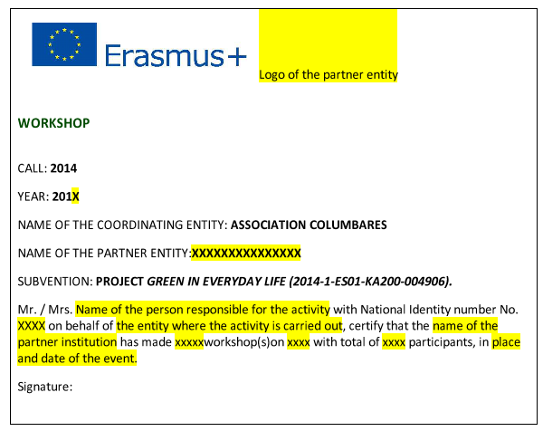

Slide 30
Results of saving energy, water and waste and changes in consumption habits and mobility: The verification will be made: In any organization at internal level: - Initial and final questionnaires completed by the beneficiarie. - Energy and water invoices obtained from the beneficiaries. - Excel document (or other format) with the data analysis. To send to Columbares: - Report with the conclusions from the analysis of the results of their GH Mini Programme, with recommendations for future work in their region. April 2016. - Information related to analysis for the Mobility Tool.
5. Monitoring, evaluation and reporting of Mini GH Programme:

Slide 31
The partners will send to Columbares: - Certificate of membership, signed by the legal representatives of each organization. - Graphic documentation (photos, videos) from the signing of such agreements or press clippings, if such exist. - Information related to the GH Network for its inclusion in the Mobility Tool.
6. Monitoring, evaluation and reporting of the International Green Homes Network:

Slide 33
The verification will consist of the following documents: - Certificate of attendance signed by Insider Access. - Online questionnaire filled in by the participant in the Mobility Tool. - Payroll confirmation and / or volunteer contract of the person who has participated in mobility. - Inclusion of the activity in the Mobility Tool by Association Columbares. - Programme of the mobility. - Certificate of attendance at language training, signed by the supplier. In addition, graphic and audiovisual material will be provided.
7. Monitoring, evaluation and reporting of the Job shadowing activity:

Slide 34
Any doubts? Suggestions? THANK YOU VERY MUCH FOR YOUR ATTENTION
Carmen Molina Navarro

