Slide 1
VARIATIONS OF SAVINGS KIT
Carmen Molina Navarro

Slide 2
1. Regard to the target group: - School. - Associations. 2. Regard to the phases of the Programme: - GH Programme in a single phase. 3. Regard to our budget 4. Regard to our local conditions: - Cold and warm countries. - Most common heating systems. - Developed and developing countries.
Variations of saving kits:

Slide 3
- Schools: We may choose to deliver either a kit for the centre, if the evaluation of the consumption takes place in the centre itself, or provide savings kits for selected parents and teachers, which may apply simultaneously saving devices and recommendations of the in their homes. It might not make sense to deliver products for cooking or cleaning. They could be replaced by others , used by children and related to the activities planned (eg reflective elements that can be combined with bike repair workshop, a cloth bag for the sandwiches, etc.).
1. Regard to the target group:

Slide 4
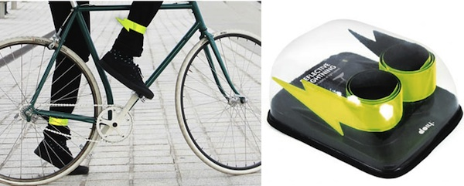
1. Regard to the target group:

Slide 5
- Associations: The number of kits can be adapted to the characteristics of the group. For example, in the case of associations whose users go to the office of the association just for a few hours, we can choose to provide a kit per household; while in shelters, prisons, with drug rehabilitation centres, etc., we can deliver one or more kits for the centres in which they users live. As with schools, we can adapt the kit to our group and planned activities. For example, to groups at risk of social exclusion it can be much more useful to receive a set of recycling bags, a cloth bag for the purchase and / or local products purchased in the market or neighborhood stores instead of organic products, because often it is more necessary to work on most basic habits than on products that the groups perhaps can not afford.
1. Regard to the target group:

Slide 6
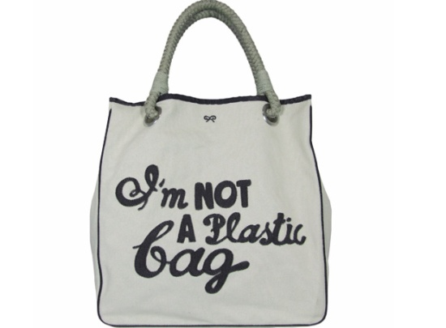
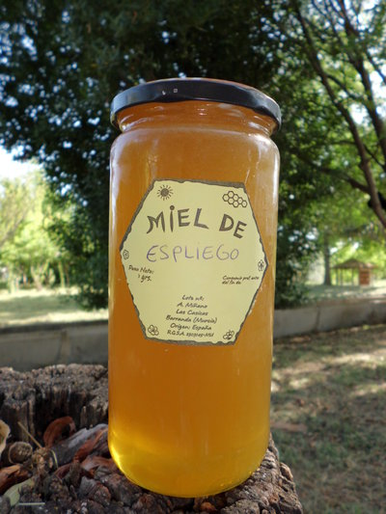
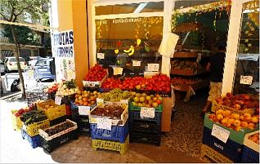
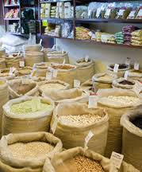
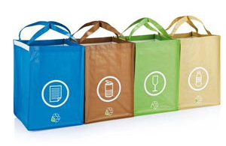
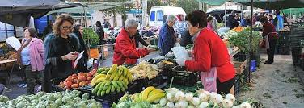
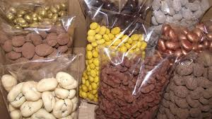
1. Regard to the target group:

Slide 7
- GH Programme in a single phase: If the Programme lasts only a year, the delivery of the kit can be done in two phases (as well as in the Programme with three phases), so that the second kit coincides with the start of the meetings or workshops on consumption. Thus, the participants remain motivated to stay in the Programme to receive the second kit.
2. Regard to the phases of the Programme:

Slide 8
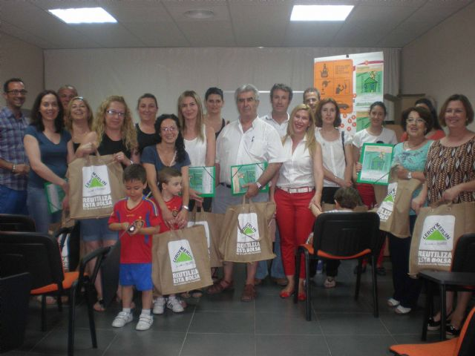
If you have a high budget, you can include more devices or devices of higher quality in your domestic savings kit. If your budget is limited, you have to adapt the kit to your possibilities. It is also possible to reach agreements with shops. For example, in Spain there is an agreement between GH Programme and Leroy Merlin.
3. Regard to our budget:

Slide 9
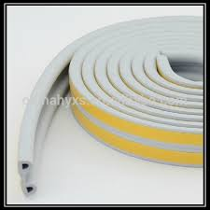
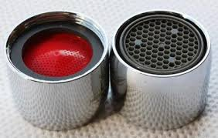
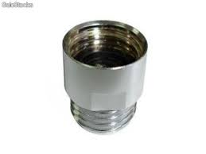
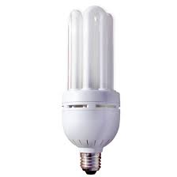
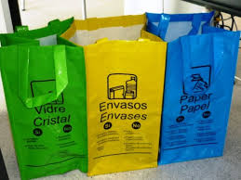
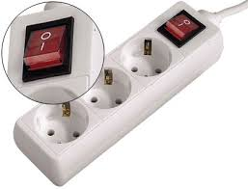
Saving kit example for 25 €:
3. Regard to our budget:

Slide 10
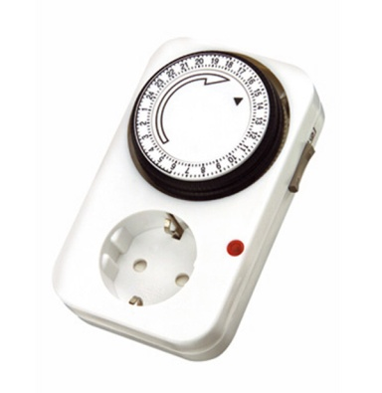
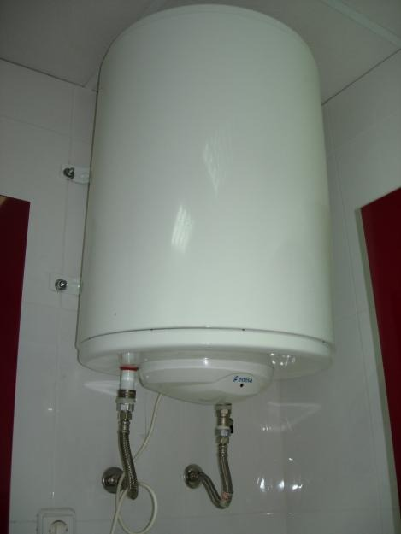
- Cold and warm countries: In cold countries the houses tend to be well insulated, so devices such as weather stripping and reminder stickers on the air conditioning will be useless. - Most common heating systems: In southern Spain electric heaters are common, so it may be useful to include a timer. This will be less useful in countries with central heating.
4. Regard to our local conditions:

Slide 11
- Developed and developing countries: Developing countries: it is much easier to find products in bulk and almost impossible to buy fair trade or ecological products. it can be more useful to provide bags for selective waste separation…
4. Regard to our local conditions:

Slide 12
THE MOST IMPORTANT THING IS THE COMMON SENSE TO ADAPT THE KIT TO: - CHARACTERISTICS OF THE GROUP - OUR BUDGET - OUR LOCAL REALITY - ACTIVITIES THAT WILL DO IN THE PROGRAMME GH.

Slide 13
Any doubts? Suggestions? THANK YOU VERY MUCH FOR YOUR ATTENTION
Carmen Molina Navarro

